Slide 1
HR Analysis: Insights into Employee Satisfaction & Performance

Slide 2
EMPLOYEE RETENTION & PERFORMANCE CHALLENGES
High Attrition Rate: Employees frequently leaving, impacting business continuity.
Difficulty in retaining top talent.
Lack of Visibility into Employee Satisfaction:
No structured feedback mechanism to measure job satisfaction.
Difficulty in identifying causes of disengagement.
Inconsistent Performance Tracking:
No centralized system to evaluate employee growth and contribution.
Lack of real-time insights into productivity trends.
Absence of Predictive HR Analytics:
No ability to forecast potential resignations.
HR decisions are reactive instead of proactive.

Slide 3
FINANCIAL & OPERATIONAL IMPACT:
High Recruitment & Training Costs:
Repeated hiring cycles strain HR budgets.
Loss of Productivity:
Frequent transitions lead to skill gaps and delays in projects.
Reduced Workforce Morale:
Low engagement leads to decreased motivation and efficiency.
Compliance Risks:
Poor HR tracking can lead to non-compliance with labor laws.

Slide 4
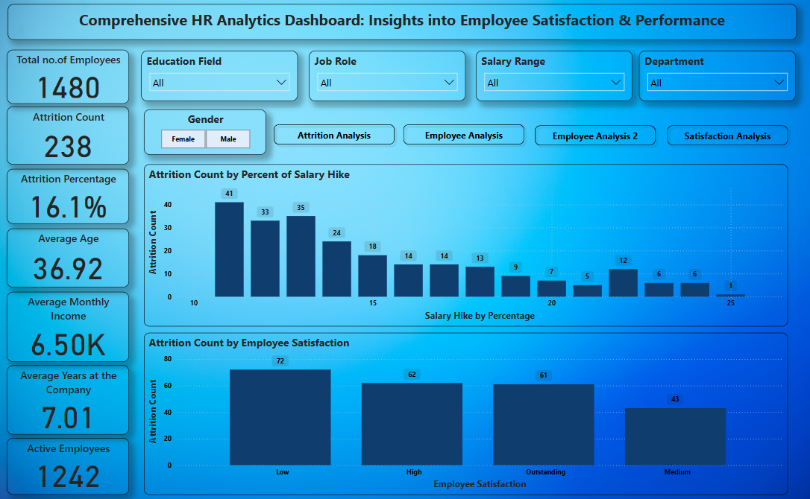
DATA-DRIVEN HR ANALYTICS DASHBOARD
Implement a Power BI Dashboard to track HR metrics.
Real-time Data Monitoring for insights into employee engagement, retention, and performance.
Automated Reports & Alerts for proactive HR decision-making.
Predictive Analytics to forecast attrition and improve workforce planning.

Slide 5
EXPECTED BUSINESS IMPACT:
Reduced Employee Turnover – By identifying attrition patterns and addressing employee concerns proactively.
Better Workforce Planning – Data-driven hiring and training decisions to improve efficiency.
Enhanced Employee Satisfaction – Using insights from engagement surveys and performance analytics.
Cost Optimization – Understanding recruitment and retention costs to improve HR budgeting.

